Slide 1

Usability Testing
Jimitkumar Patel
Krishang Patel
Sandeep Singh

Slide 2

Topic
North Carolina Department of Health
Top most priority is health and well-being of individuals they serve
Created a SAAS application targeted for healthcare systems

Slide 3
What is an SAAS Application?
Software as a Service Application
Hosted in the cloud and accessed through the internet
Maintained by third party provider
Accessible through multiple devices
Popular SAAS Products:
Google Workspace
Slack
Spotify
Netflix
Zoom

Slide 4
Targeted Audience
Department of healthcare professionals
Department of administrators
Patients
Other staff member

Slide 5
Conducting Test
Test Participants
Healthcare Professionals
Doctors
Nurses
Social Workers
Served Population
Patients
Beneficiaries
Designated usability test moderators
Test Environments
Controlled testing lab with observation facilities
Remote testing
Participants’ natural environment
Mobile devices
Web browsers

Slide 6

Healthcare Professional and Patient Scenarios
Healthcare Professionals
User Registration
Accessing Patient Information
Task Assignments
Communication
Served Population
User Registration
Access to Health Information
Communication
Medication Management
Feedback and Support

Slide 7

Testing Methodology
Moderated Testing
Think-Aloud Protocol
Surveys and Questionnaires
Task Success Metrics
Observation

Slide 8

Data Collection
Data Analysis
Record session videos and screen captures.
Collect survey responses, feedback, and task success rates.
Document usability issues, suggestions, and user comments.
Analyze videos, surveys, and user comments to identify usability issues.
Categorize issues by severity (critical, major, minor) and priority.
Create usability testing reports with actionable recommendations.

Slide 9
Iterative Testing
Make necessary design and functionality changes based on the initial usability testing findings.
Conduct additional rounds of usability testing to validate improvements.

Slide 10
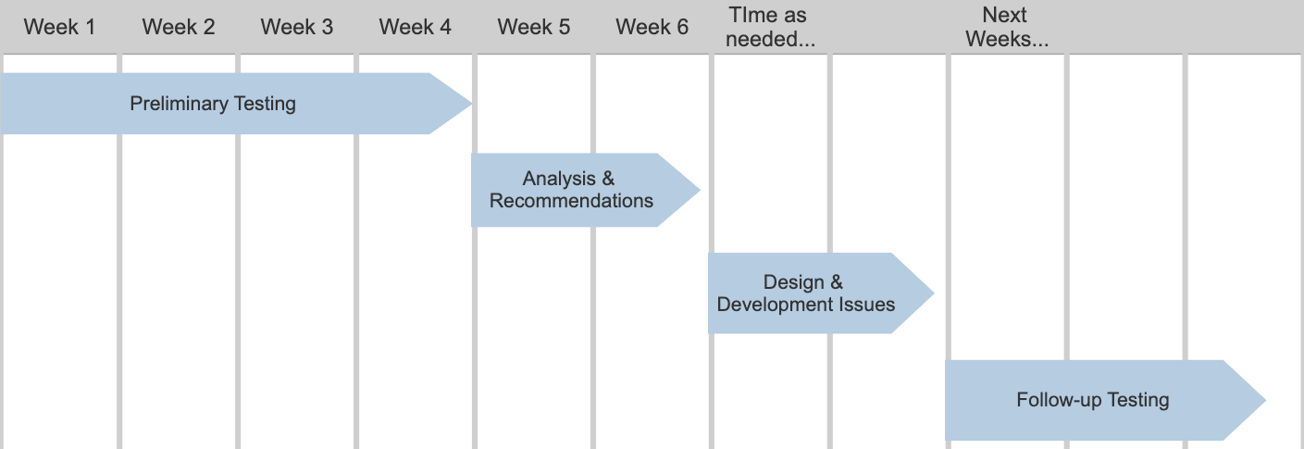
Timeline
Reporting
Present usability testing reports to the NCDHHS project stakeholders.
Prioritize and schedule necessary improvements based.

Slide 11

Questions

Slide 12
Sources
https://developer.apple.com/design/human-interface-guidelines/
https://www.techtarget.com/searchcloudcomputing/definition/Software-as-a-Service
https://www.hhs.gov/guidance/
https://www.nngroup.com/articles/surveys-design-cycle/
https://www.nngroup.com/videos/pilot-test/

